Slide 1
HUMAN ACTIVITY RECOGNITION-VISION BASED APPROACH
PREDENTED BY:
2010030512_L.Keerthana
2010030517_M.Manideepa
2010030526_D.Dedeepya
2010030530_K.Sriteja
GUIDED BY:
DR.ARPITA GUPTHA

Slide 2
OUTLINE
FLOW DIAGRAM
GIT COMMITS
PRE-PROCESSING CODE AND TECHNIQUES
SELECTED MODEL

Slide 3
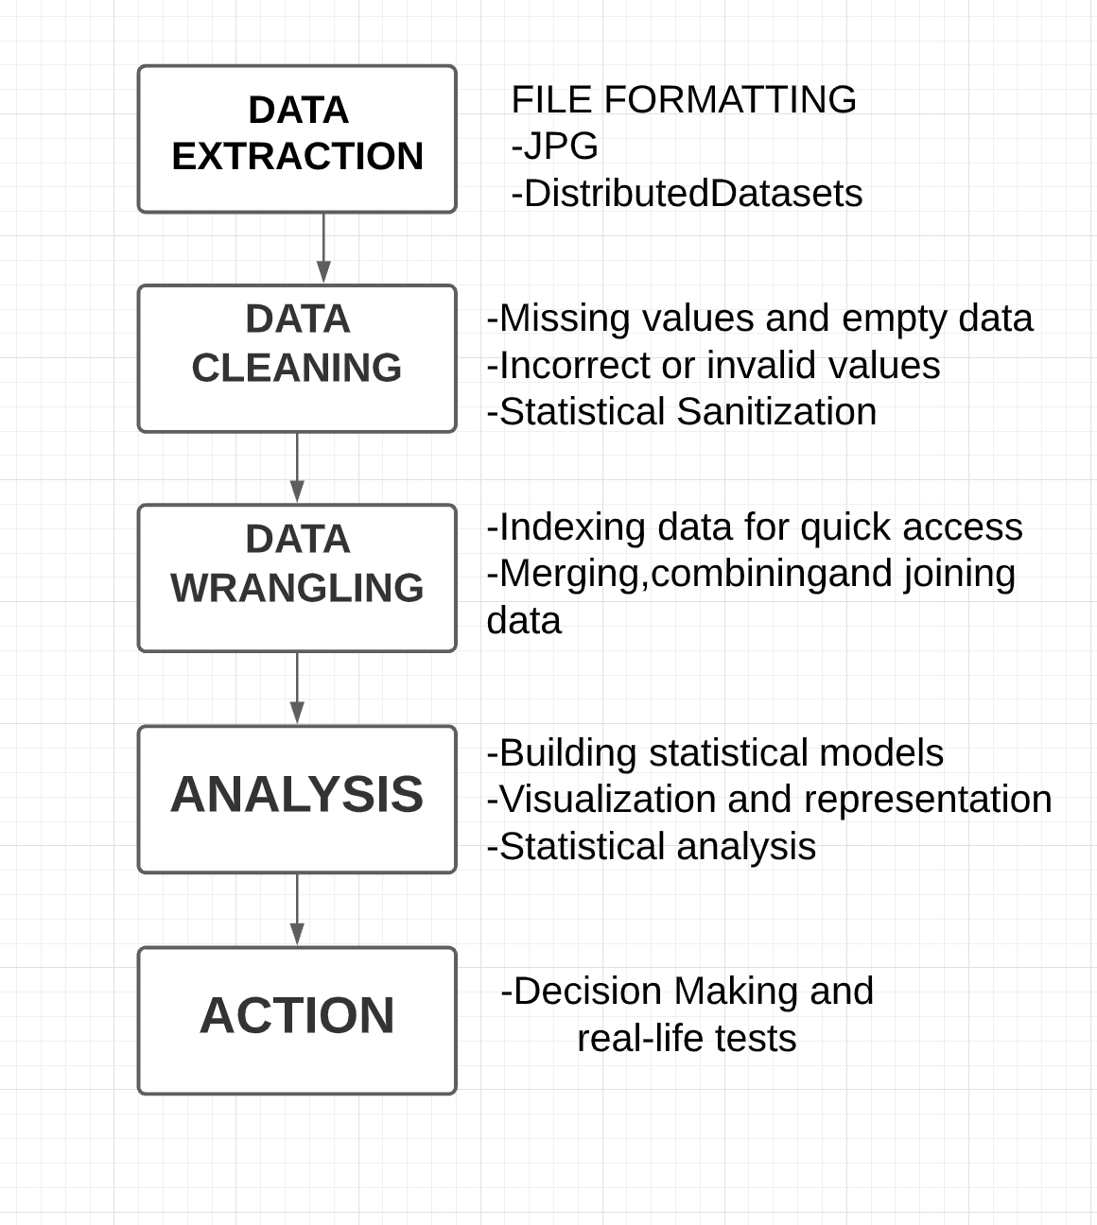
FLOW CHART

Slide 4
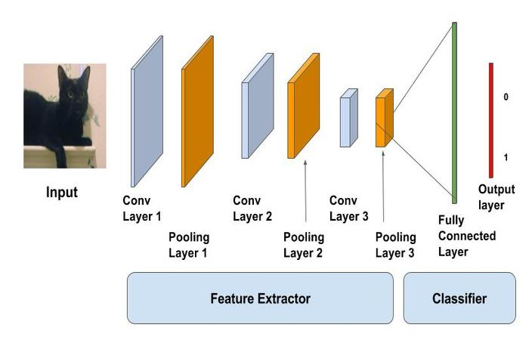
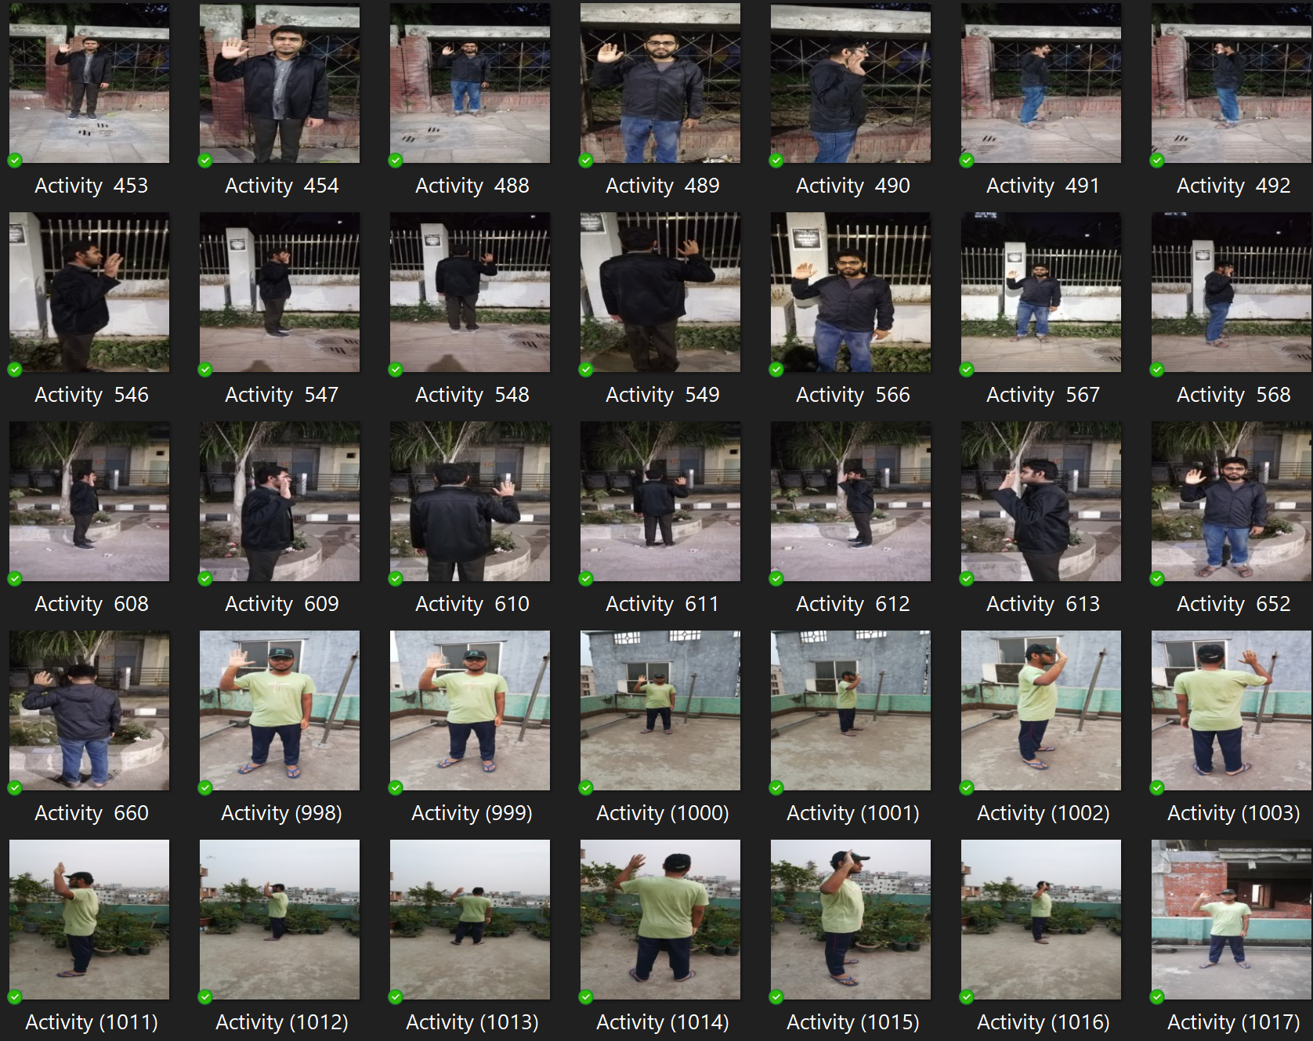
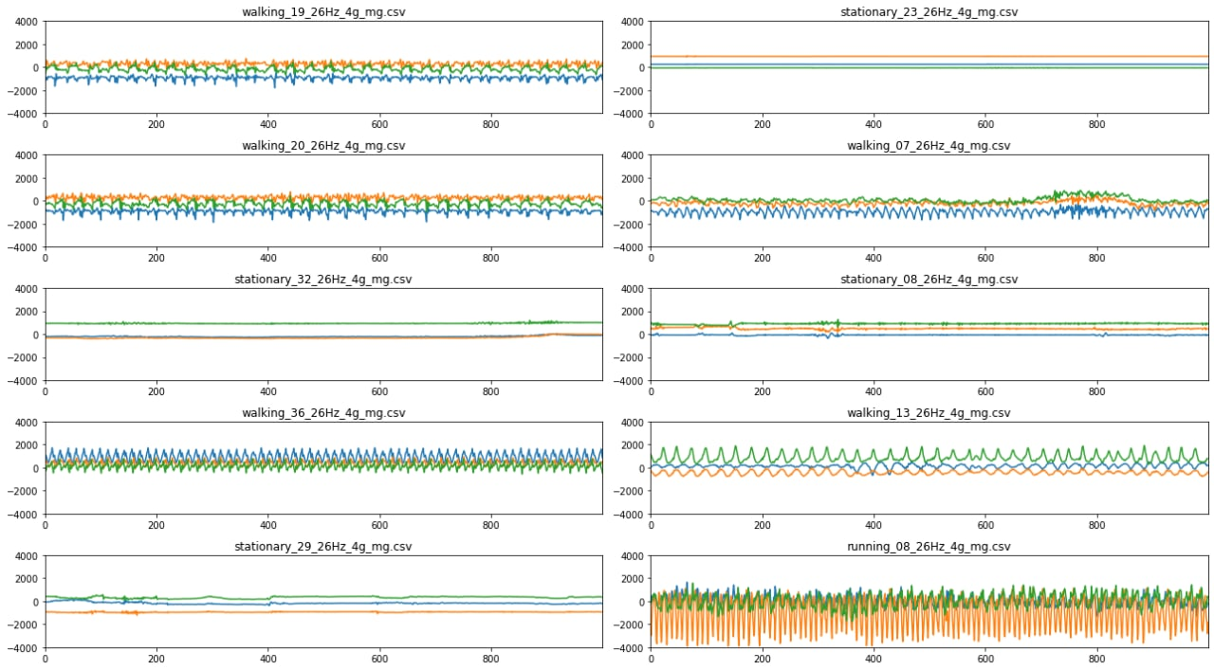
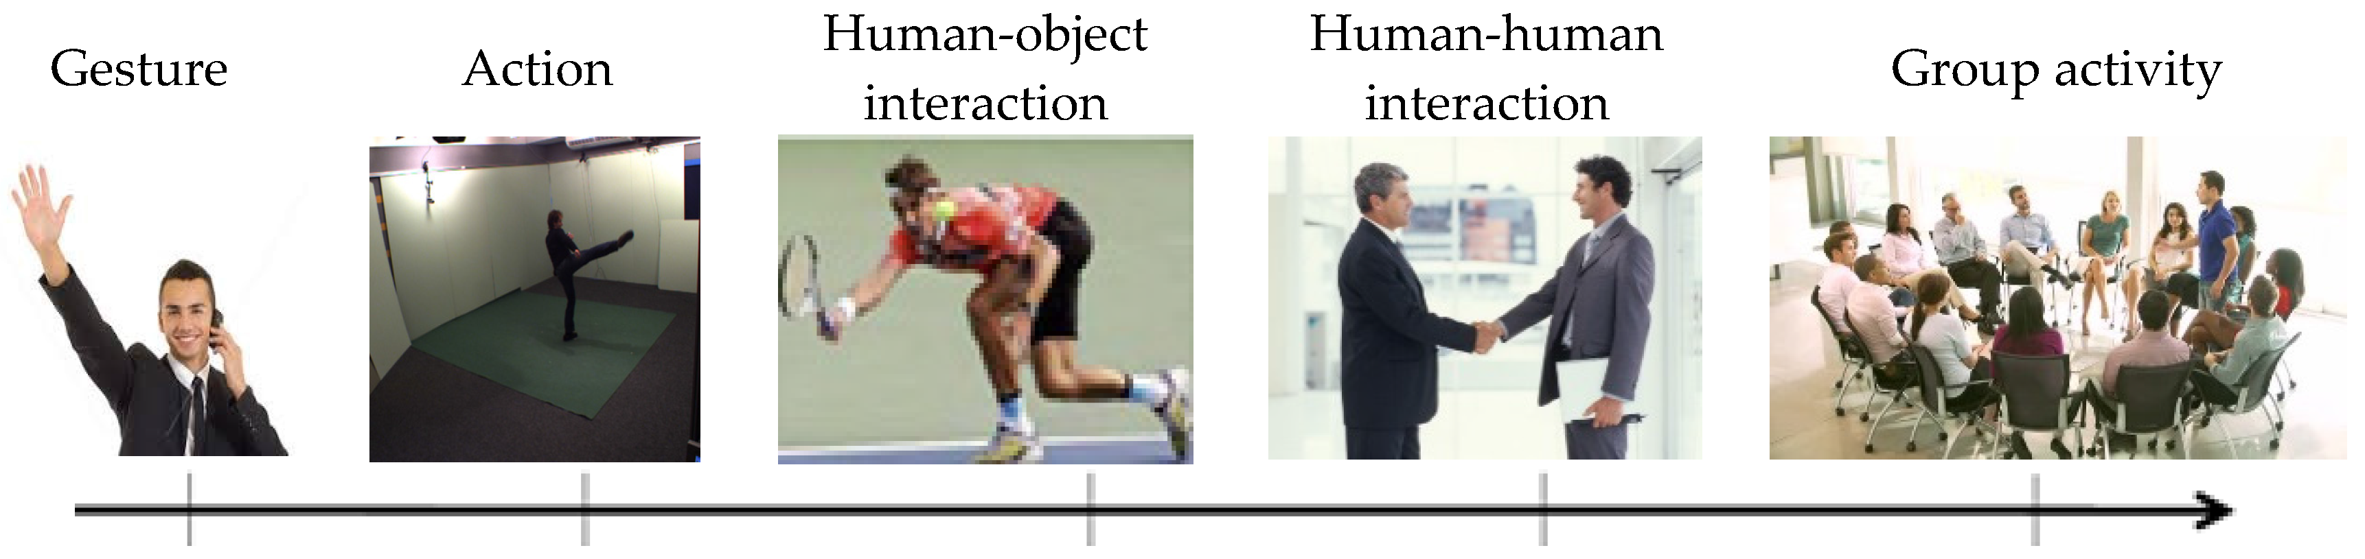
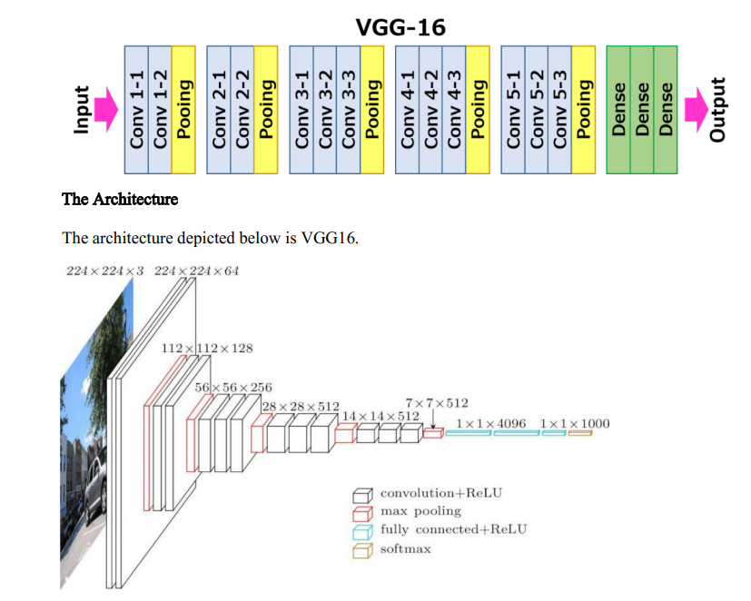
DATASET
CNN Model it takes in an input image, assign importance (learnable weights and biases) to various aspects/objects in the image and be able to differentiate one from the other.
DATAPREPROCESSING
is done by noise reduction and segmentation
VGG16 is a simple and widely used Convolutional Neural Network (CNN) Architecture used for ImageNet, a large visual database project used in visual object recognition software research.
WORKING PROTOTYPE
MODEL EVALUATION

Slide 5
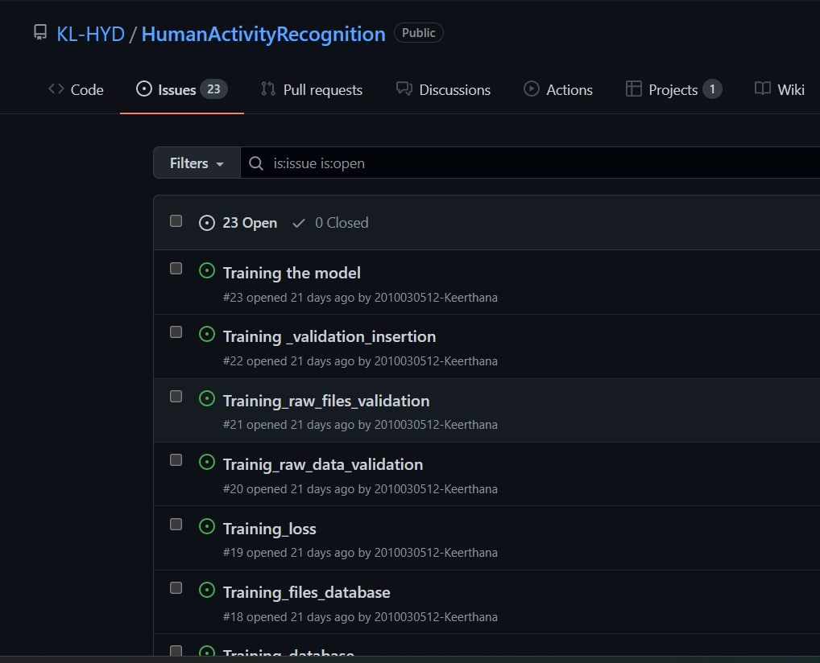

GITHUB-COMMITS

Slide 6



PREPROCESSING CODE

Slide 7
TECHNIQUE USED
Image Segmentation
Image segmentation is a method in which a digital image is broken down into various subgroups called Image segments which helps in reducing the complexity of the image to make further processing or analysis of the image simpler.
Segmentation in easy words is assigning labels to pixels. All picture elements or pixels belonging to the same category have a common label assigned to them.
For example: Let’s take a problem where the picture has to be provided as input for object detection. Rather than processing the whole image, the detector can be inputted with a region selected by a segmentation algorithm. This will prevent the detector from processing the whole image thereby reducing inference time.

Slide 8
SELECTED MODEL
CNN is a type of deep learning model for processing data that has a grid pattern, such as images.CNN is mainly used in image analysis tasks like Image recognition, Object detection & Segmentation.
Very Deep Convolutional Networks for Large-Scale Image Recognition(VGG-16) The VGG-16 is one of the most popular pre-trained models for image classification.
Image classification techniques can mainly be divided into two different categories: pixel-based classification and object-based classification. Pixels are the base units of an image, and the analysis of pixels is the primary way that image classification is done.
VGG16 is object detection and classification algorithm which is able to classify 1000 images of 1000 different categories with 92.7% accuracy. It is one of the popular algorithms for image classification and is easy to use with transfer learning.
VGG-16 is considered to be one of the excellent vision model architecture till date

Slide 9
REFERENCE LINKS
Sengupta, Akash, Ignas Budvytis, and Roberto Cipolla. "Synthetic training for accurate 3d human pose and shape estimation in the wild." arXiv preprint arXiv:2009.10013 (2020).
Chong, Eunji, Yongxin Wang, Nataniel Ruiz, and James M. Rehg. "Detecting attended visual targets in video." In Proceedings of the IEEE/CVF Conference on Computer Vision and Pattern Recognition, pp. 5396-5406. 2020.
Liang, Junwei. "From Recognition to Prediction: Analysis of Human Action and Trajectory Prediction in Video." arXiv preprint arXiv:2011.10670 (2020).
Badal, Varsha D., Ellen E. Lee, Rebecca Daly, Emma M. Parrish, Ho-Cheol Kim, Dilip V. Jeste, and Colin A. Depp. "Dynamics of Loneliness Among Older Adults During the COVID-19 Pandemic: Pilot Study of Ecological Momentary Assessment With Network Analysis." Frontiers in Digital Health 4 (2022).
Wan, Shaohua, Lianyong Qi, Xiaolong Xu, Chao Tong, and Zonghua Gu. "Deep learning models for real-time human activity recognition with smartphones." Mobile Networks and Applications 25, no. 2 (2020): 743-755.

